Slide 1

Cyberbulling Detection
By:
John Hani
Mohamed Nashaat
Mostafa Ahmed
Zeyad Emad
Under supervision of :
Dr. Eslam Amer
Eng. Menna Gamil

Slide 2
Agenda
Introduction
Related work
Problem Statement
System overview
Project Deliverables

Slide 3


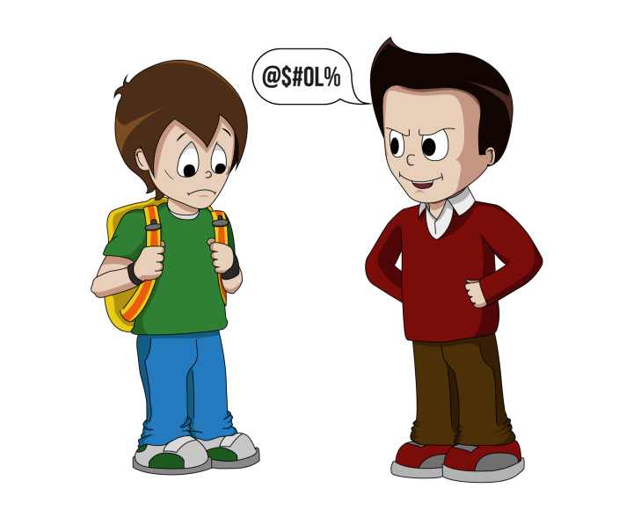
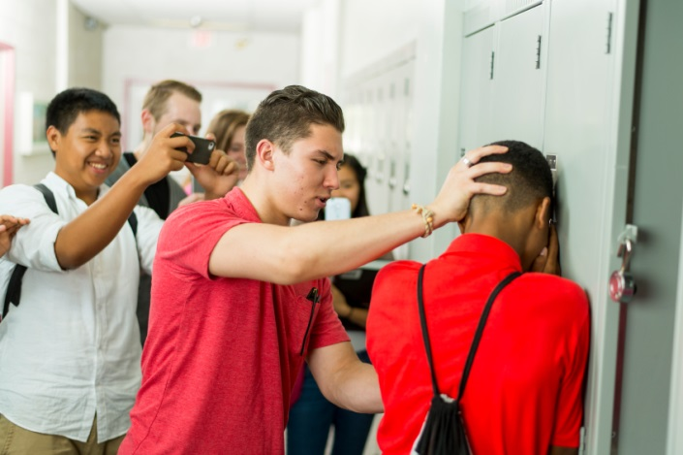
Introduction
Use superior strength or influence to intimidate someone

Slide 4

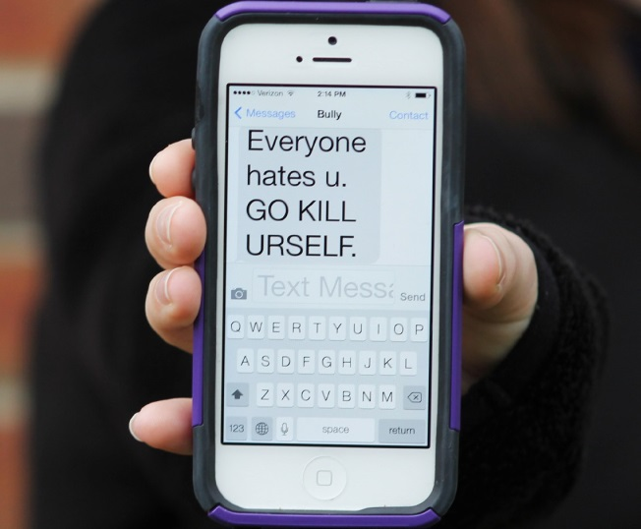
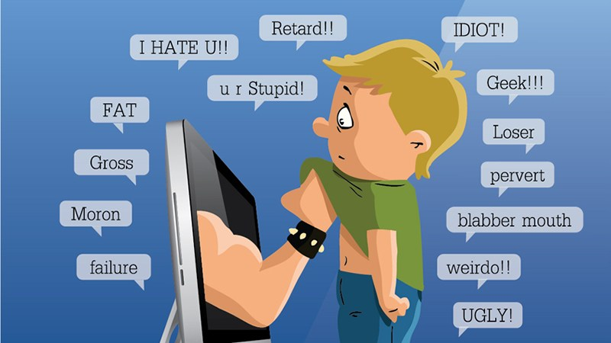
Cyberbullying has been manifesting our youth for quite sometime, due to them being involved in one form of social media communication or another.

Slide 5
More than 1 in 3 young people have experienced cyber threats online.
Over 25 percent of adolescents and teens have been bullied repeatedly through their cell phones or the Internet.
National Crime Prevention Council, “Cyberbullying”
i-SAFE Inc., “Cyber Bullying: Statistics and Tips”
Richard Webster, Harford County Examiner, “From cyber bullying to sexting: What on your kids’ cell?”

Slide 6
Related Work
Motivation
The current efforts of detecting cyberbullying are largely absent or naive.
Main Problem
The problem is to tackle the various forms of cyberbullying cases.
Contribution
They made a new prototype for automatic cyberbullying detection.
Precision
69.0% precision using SVM

Slide 7
Related Work
Motivation
There is an enormous amount of information to manually flag offensive comments or posts. So an automatic classifier that is fast and effective is needed to solve this problem.
Main Problem
There are challenges like: special characters in comments and the detection of insults and offensive comments
Contribution
They proposed 2 new hypotheses for detecting cyberbullying and it has increased the precision by 4 percent.
Precision
70.0% precision using SVM
64.0% precision using logistic regression

Slide 8
Problem Statement

Slide 9
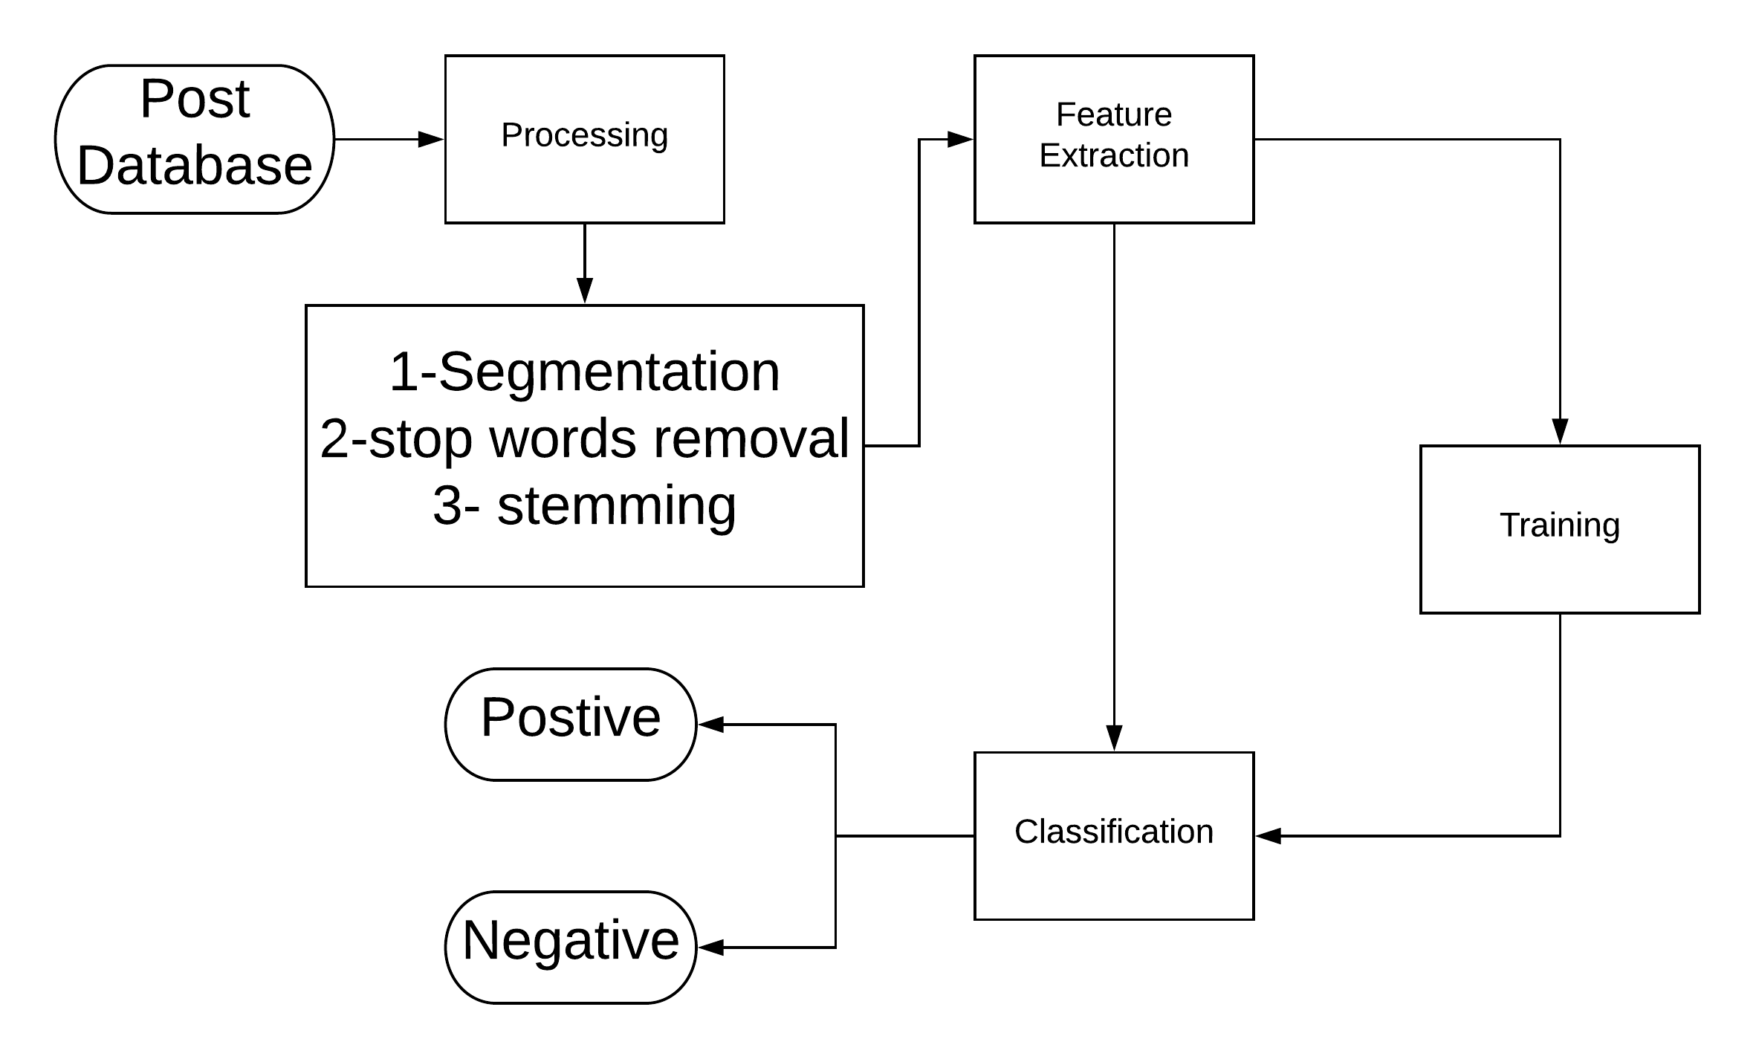
System overview

Slide 10
Input and Preprocessing
-Step 1:We take the posts from database.
-Step 2: Segmentation
-Step 3: Remove Stop words
-Step 4: Stemming of words
-Step 5: Solution for the obfuscation of words

Slide 11
Processing
Sentiment analysis
Context analysis
Deep Learning Classification

Slide 12
Output
-Determination of whether the post is cyberbullying or not.
-Finally, we take steps to prevent this from happening again Like: Alerting Parents and blocking the bully.

Slide 13
4.1 Tasks and Time plan
Task Name | From | To
Idea Discussion | 1/8/2018 | 1/8/2018
Idea Research | 1/8/2018 | 13/9/2018
Proposal Writing | 13/9/2018 | 16/9/2018
Implementing Prototype | 16/9/2018 | 17/9/2018
Delivering Rehearsal | 18/9/2018 | 18/9/2018
Delivering Proposal | 18/9/2018 | 26/9/2018
Doing Survey | 10/10/2018 | 20/10/2018
Implementing Second Prototype | 20/10/2018 | 25/10/2018
Writing SRS | 25/10/2018 | 30/10/2018

Slide 14
4.1 Tasks and Time plan Cont.
Implementing | 30/10/2018 | 25/11/2018
Preparing for External Examiner | 25/11/2018 | 3/12/2018
Implementing | 3/12/2018 | 18/1/2019
Writing SDD | 18/1/2019 | 1/2/2019
Implementing | 1/2/2019 | 1/4/2019
Preparing for Implementation Evaluation | 1/4/2019 | 25/4/2019
Writing 8 Pages Paper | 25/4/2019 | 28/4/2019
Finalizing Implementation | 28/4/2019 | 7/5/2019
Writing Final Thesis | 10/5/2019 | 25/5/2019
Presenting Final Thesis | 25/6/2019 | 25/6/2019

Slide 15
4.2 Budget and Costs $$
No Costs are Needed for this Project up till now

Slide 16
4.3 Supportive Documents
”A Multilingual System for Cyberbully Detection: Arabic Content Detection using Machine Learning” By Batoul Haidar, Maroun Chamoun, Ahmed Serhrouchni.
”Cyberbullying Detection using Time Series Modeling” By Nektaria Potha, Manolis Maragoudakis
”Cybercrime detection in online communications: The experimental case of cyberbullying detection in the Twitter network” By Mohammed Ali Al-garadi , Kasturi Dewi Varathan , Sri Devi Ravana
”Machine Learning Approach for Detection of Cyber-Aggressive Comments by Peers on Social Media Network” By Vikas S Chavan , Shylaja S S
”Machine learning and semantic analysis of in-game chat for cyber bullying” By Shane Murnion , William J Buchanan , Adrian Smales , Gordon Russell
”Unsupervised Cyber Bullying Detection in Social Networks” By Michele Di Capua , Emanuel Di Nardo, Alfredo Petrosino
”Cyberbullying System Detection and Analysis” By Yee Jang Foong , Mourad Oussalah

Slide 17
Any Questions?

